Slide 1

Customer Shopping Behavior Analysis
Exploring 3,900 purchase transactions to uncover actionable insights on spending patterns, product preferences, and customer loyalty trends.

Slide 2
Dataset Overview
3,900
18
0.9%
Transactions
Data Points
Missing Data
Purchase records analyzed
Features per transaction
Only 37 missing review ratings
Customer Demographics
Shopping Behavior
Age, Gender, Location
Discounts & Promo Codes
Subscription Status
Review Ratings & Shipping

Slide 3

Data Preparation Process
01
02
Data Loading & Exploration
Missing Value Treatment
Imported dataset using pandas and analyzed structure with summary statistics.
Imputed missing review ratings using median rating per product category.
03
04
Feature Engineering
Database Integration
Created age_group segments and purchase_frequency_days for deeper analysis.
Loaded cleaned dataset into PostgreSQL for advanced SQL analysis.

Slide 4
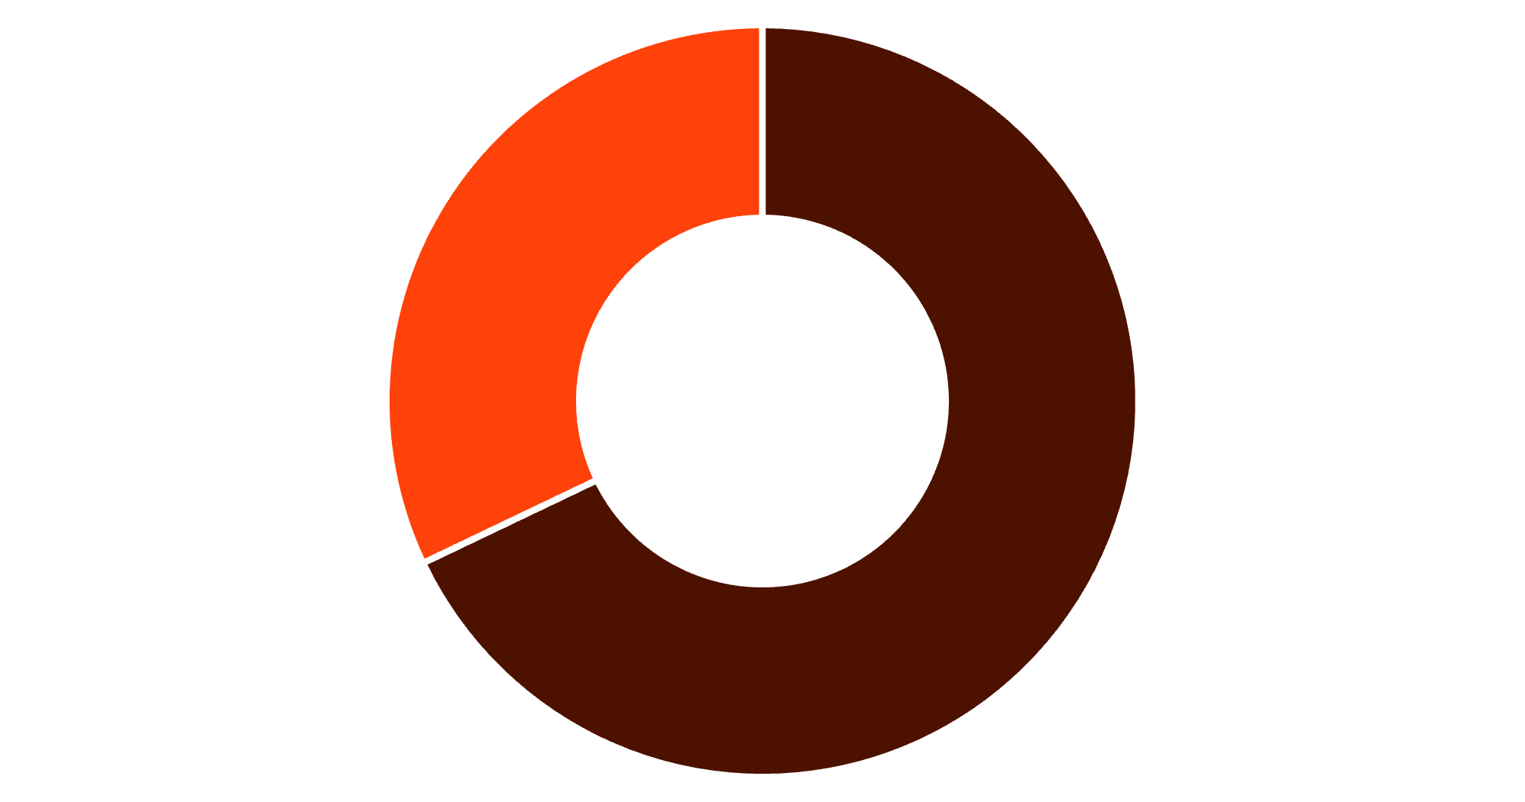
Revenue by Gender
Key Finding
Males contribute 68% of total revenue, suggesting higher purchase frequency or larger order values.
This presents opportunities for targeted marketing campaigns.
Male
Female

Slide 5

Top-Rated Products
Handbag
Jewelry
Sunglasses
Shoes
Rating: 4.2/5
Rating: 4.1/5
Rating: 4.0/5
Rating: 3.9/5
Accessories and footwear dominate top-rated items—ideal for featured listings and promotional highlights.

Slide 6

Shipping & Spending Patterns
Express Shipping
Average spend: $61.85
Customers willing to pay for convenience spend 3.5% more per order.
Standard Shipping
Average spend: $59.76
Majority of customers prefer standard delivery with consistent spending.
Express shipping users demonstrate higher willingness to pay—target them with premium product offerings.

Slide 7



Customer Loyalty Insights
80%
Loyal Customers
Strong retention base
33%
Subscriber Rate
Among repeat buyers
Subscription Analysis
Subscribers spend similarly per order as non-subscribers. The revenue gap stems from smaller subscriber numbers, not lower spending power.
80%+ loyal customer base indicates strong retention—expand loyalty programs to maximize lifetime value.

Slide 8
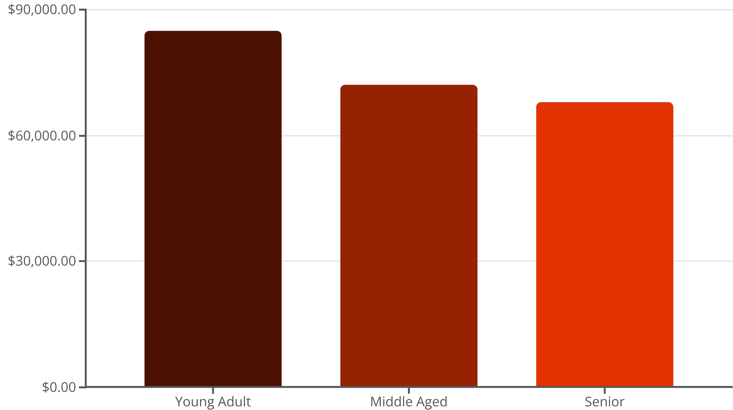
Revenue by Age Group
Young Adults Lead
Consistent Spending
Generate the highest revenue, making them the most active and valuable shopping segment.
Older age groups maintain relatively steady spending patterns across categories.

Slide 9

Discount-Sensitive Products
High Discount Dependency
Certain products show strong price sensitivity—discounts drive majority of sales.
Evaluate profitability margins
Consider bundling strategies
Smart Bargain Hunters
Customers applying discounts but spending above average ($59.76) represent premium discount shoppers.
Target for upselling with coupons
Offer exclusive early access deals

Slide 10





Strategic Recommendations
Subscription Growth
Promote exclusive perks like free express shipping and early access to boost repeat buyer conversion.
Loyalty Programs
Implement tiered rewards for frequent customers to strengthen retention and brand loyalty.
Targeted Campaigns
Personalize offers for Young Adults and Express shipping users for higher engagement.
Product Marketing
Spotlight top-rated and top-selling items to increase conversion and customer trust.

